Slide 1
Syracuse Hospital management system
CSE686– April 30 2018
By,
Ziqi Wang
Xiaojun Zhang
Yufei Fang
Yue Zhao
Chenyang Du
Huiyuan Li
Haiyang Zhang
Hanyi Li

Slide 2
Syracuse Hospital management system
Overview
Our project is Syracuse Health Center Management System. Our system has realized centralized and unified management of hospital medical information.

Slide 3
Syracuse Hospital management system
1.manage appointments and register a health history record for new patients.
2. handle the patient to pay and get medicine.
1
3
Edit & Update Medicine Information
Administrator Mode
Receptionist mode
Doctor mode
Warehouse mode
Do employee management(update delete employee information)
Do administrator management(update delete administrator information)
Do log management to view all the operations of employees
2
4
1. Edit and view health history;
2. Edit prescription for each patient;

Slide 4
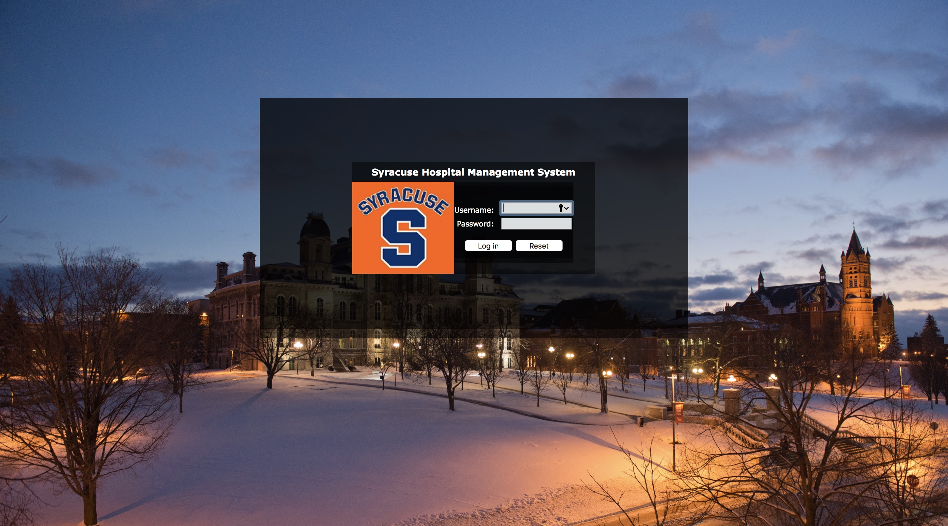
Login page

Slide 5
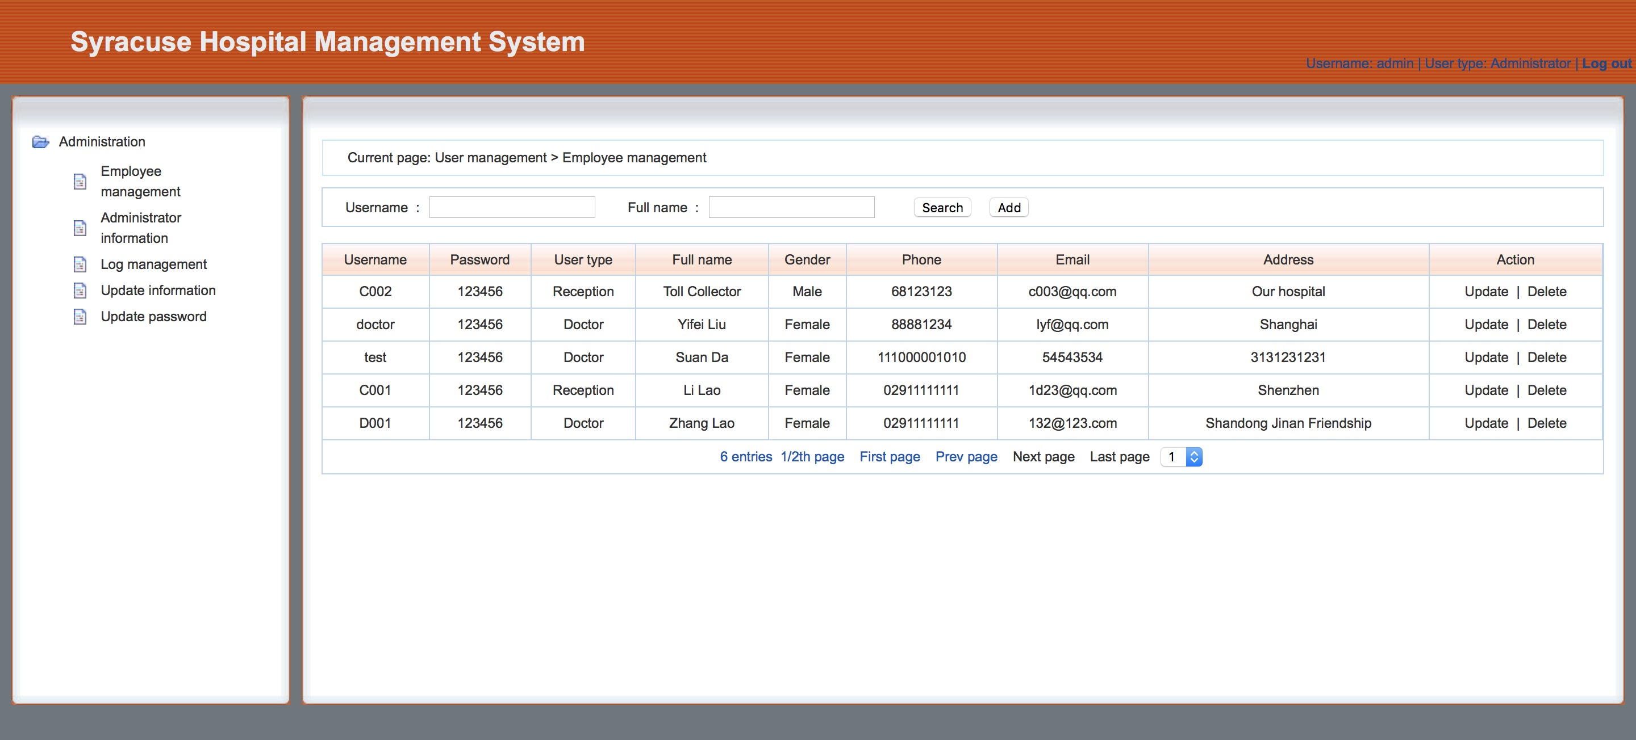
Administrator Mode
Do employee management(update delete employee information)
Do administrator management(update delete administrator information)
Do log management to view all the operations of employees

Slide 6
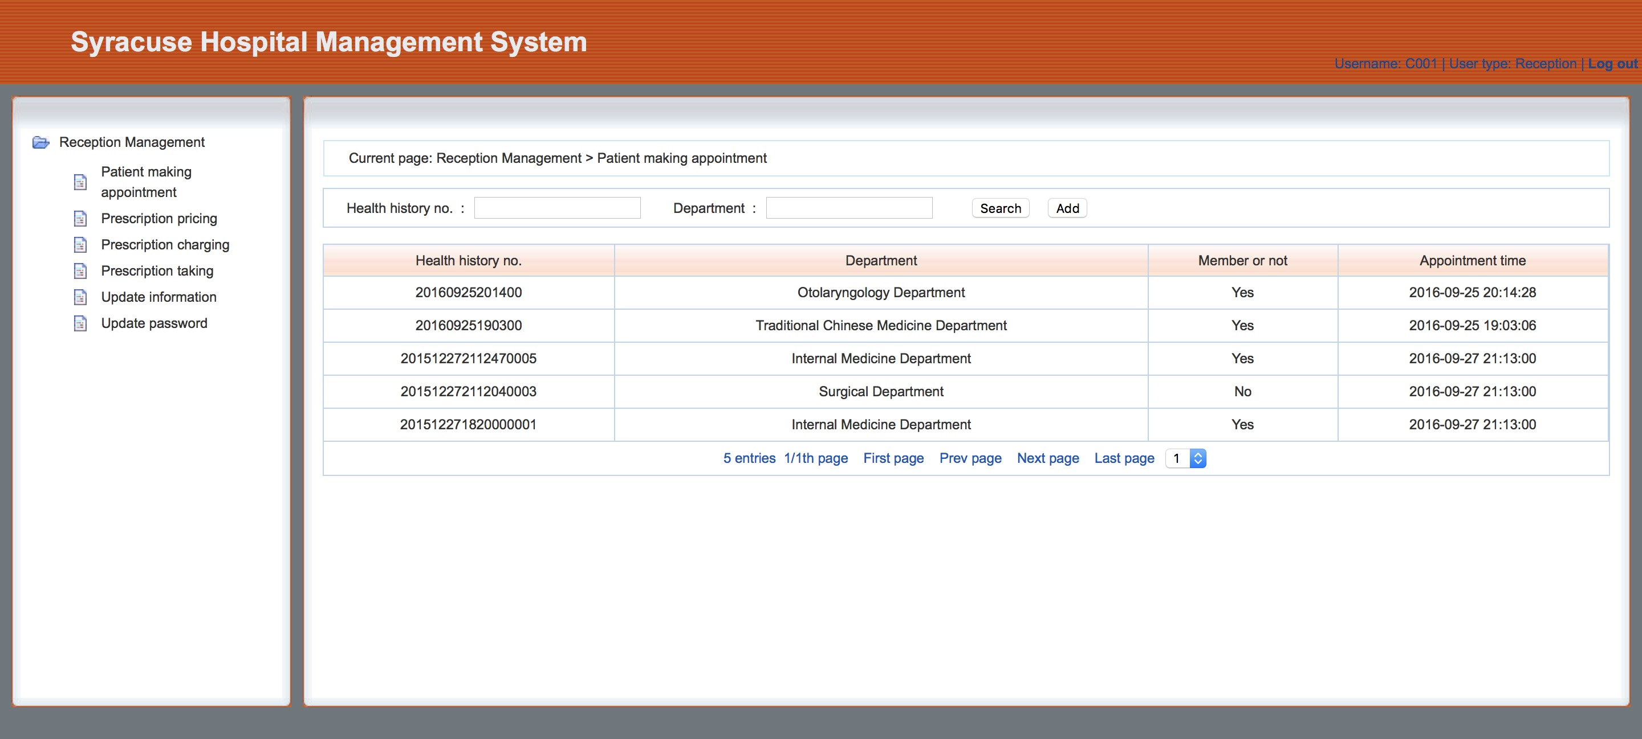
Receptionist mode
1.manage appointments and register a health history record for new patients.
2. handle the patient to pay and get medicine.

Slide 7
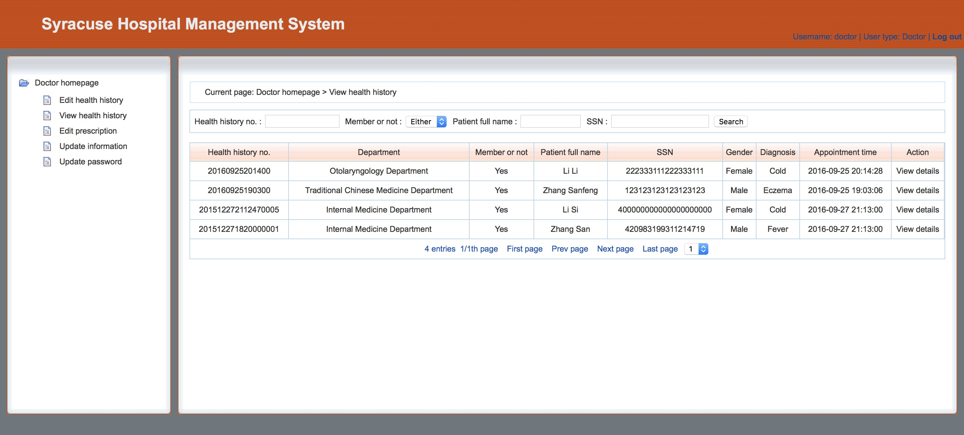
Doctor mode
Receptionist mode
1. Edit and view health history;
2. Edit prescription for each patient;

Slide 8
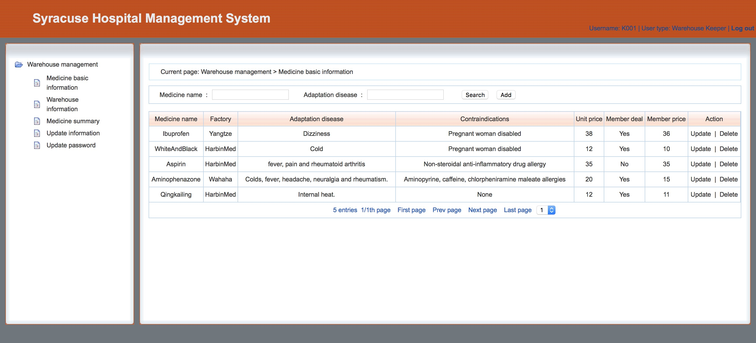
Warehouse mode
Warehouse mode is used to record the medicine inventory. For example, after a patient has got his/her medicine, warehouse keeper should update the quantity of this kind of medicine via our system.

Slide 9
Development Environment and key Technics
Database: MySQL
Server: Tomcat
Jsp, Servlet, Jdbc, Js, Ajax

Slide 10
Work flow

Slide 11
Features and Advantages
Log management
Our database keeps a log table which is used to record each operation from employees.
Coherence and practical
Our data in database keeps coherence and practical.
Security
Our system focus on solving computer security problems

Slide 12
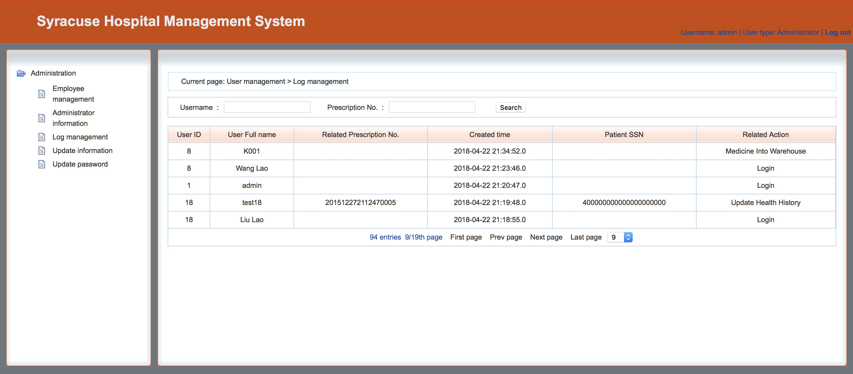
Log management
Our database keeps a log table which is used to record each operation from employees.

Slide 13
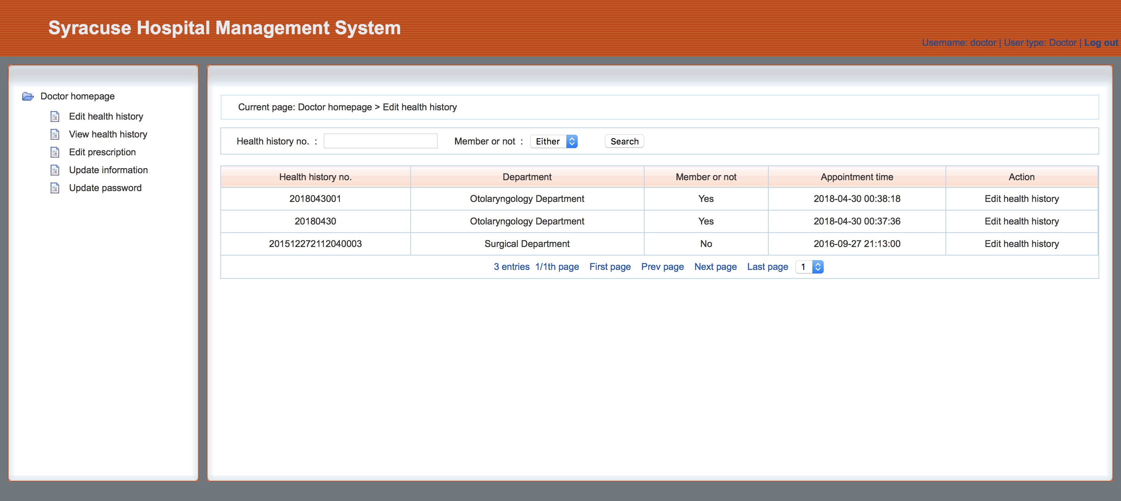
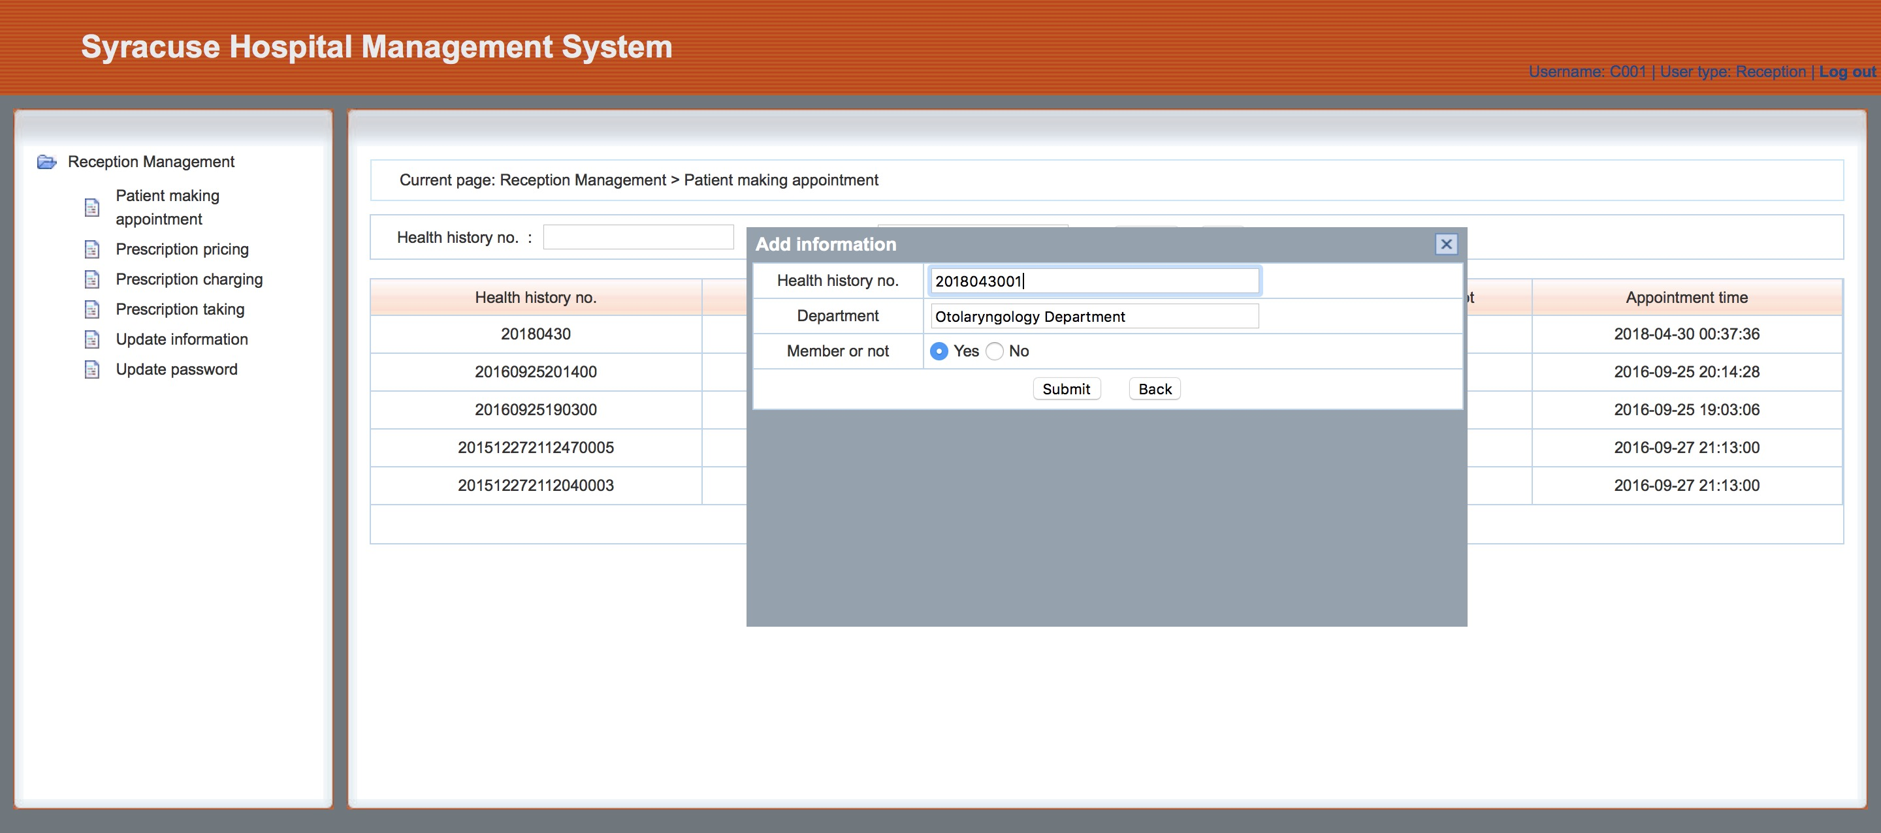
Coherence and practical
Our data in database keeps coherence and practical （reception and doctor, reception and warehouse keeper）

Slide 14
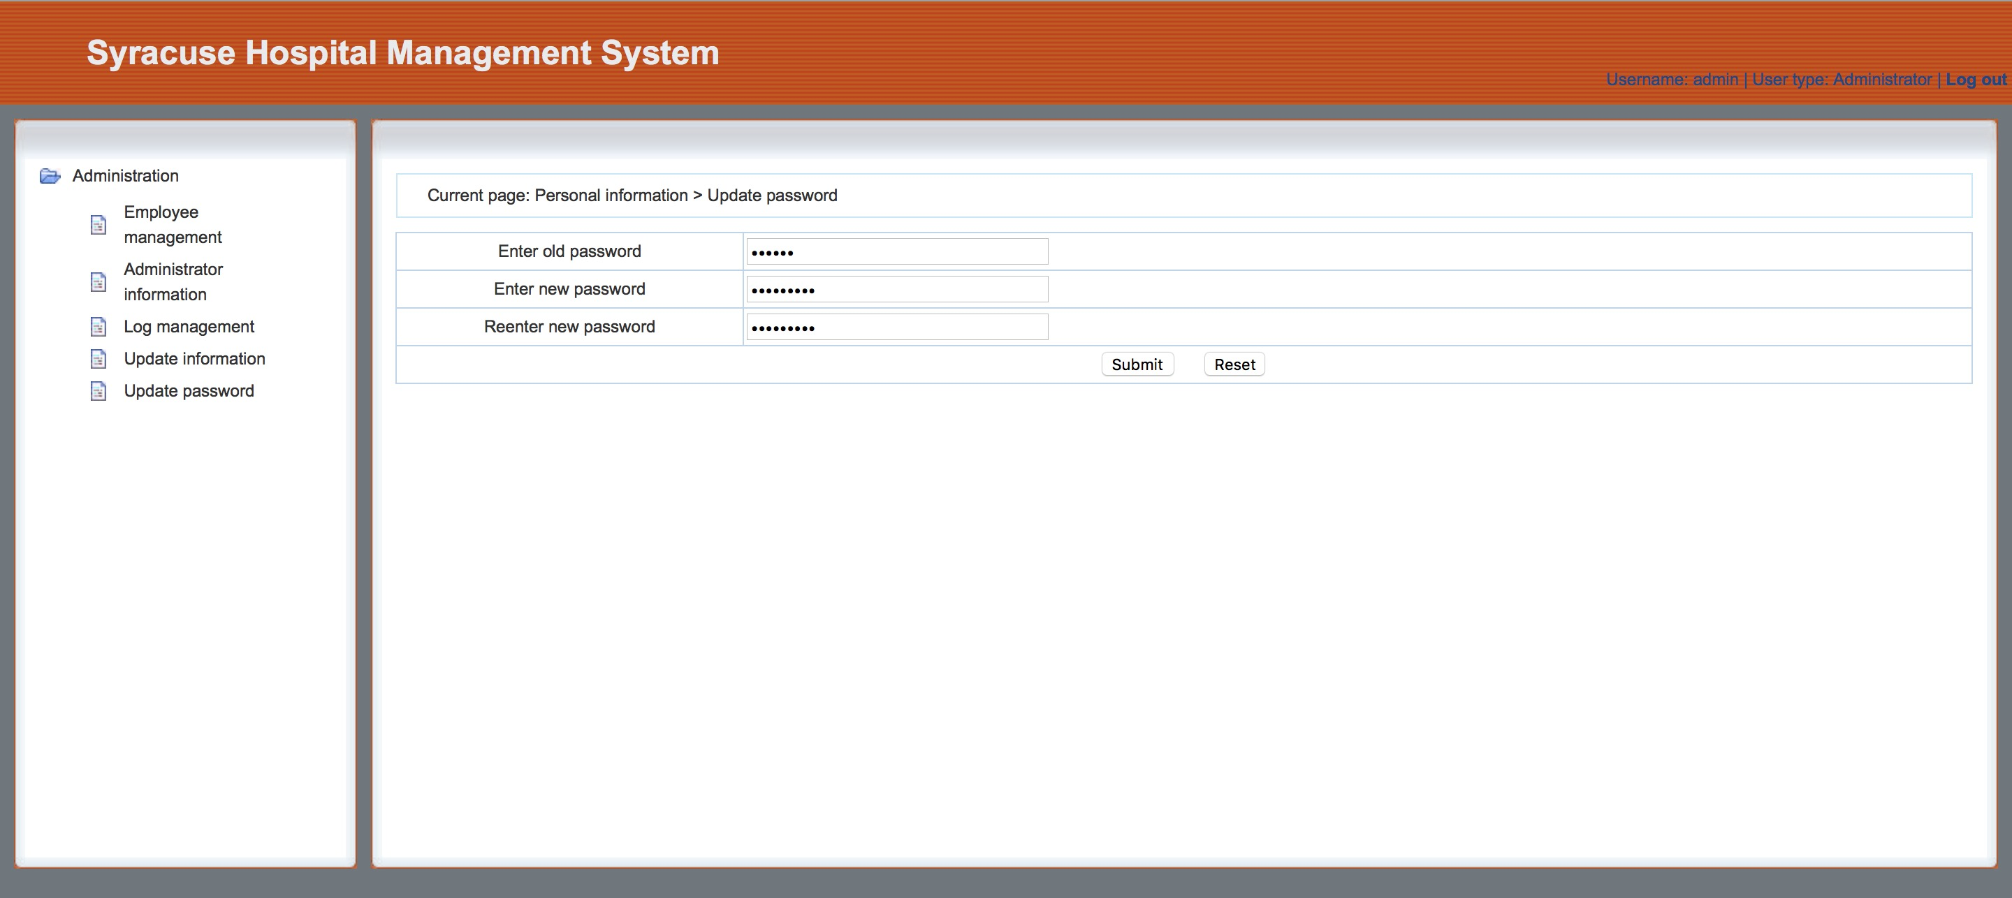
Security
Our system focus on solving computer security problems. invisible password, use hash value of pw to log in, avoid sql injection, avoid csrf, avoid xss

Slide 15
Thank You!

